Slide 1
UML. Class Diagrams
IT Academy

Slide 2

What is UML?
UML (Unified Modeling Language) is standard graphical language for specifying, visualizing, constructing, and documenting the artifacts of software systems.
UML simplifies the complex process of software design.
UML uses graphical notation to communicate that is more clearly than natural language (imprecise) and code (too detailed).
UML helps acquire an overall view of a system.
UML is not dependent on any language or technology.
UML moves us from fragmentation to standardization.

Slide 3
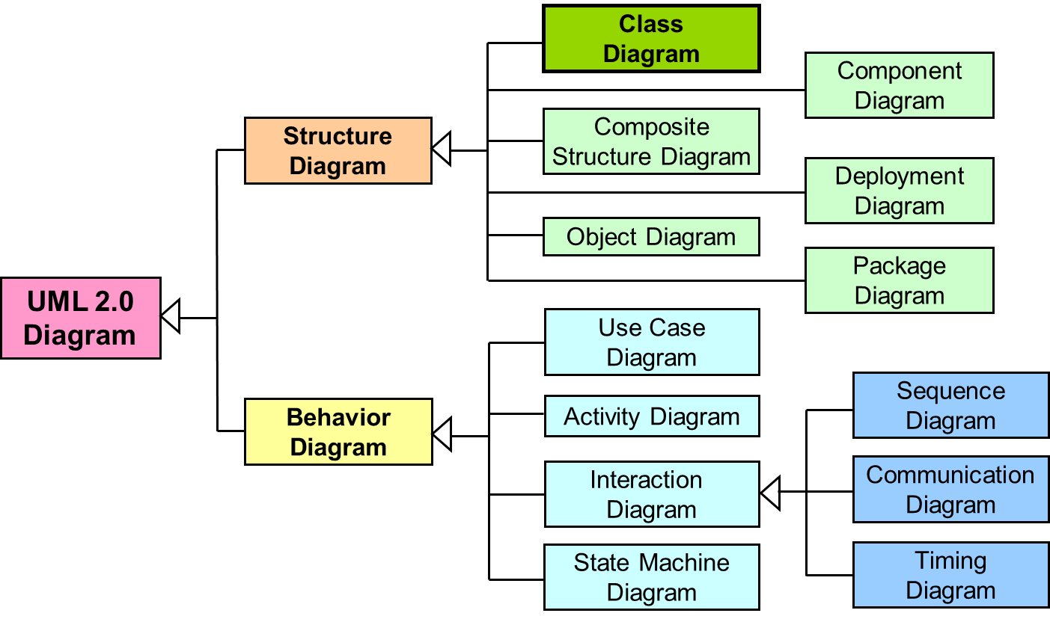
Classification of Diagram Types

Slide 4
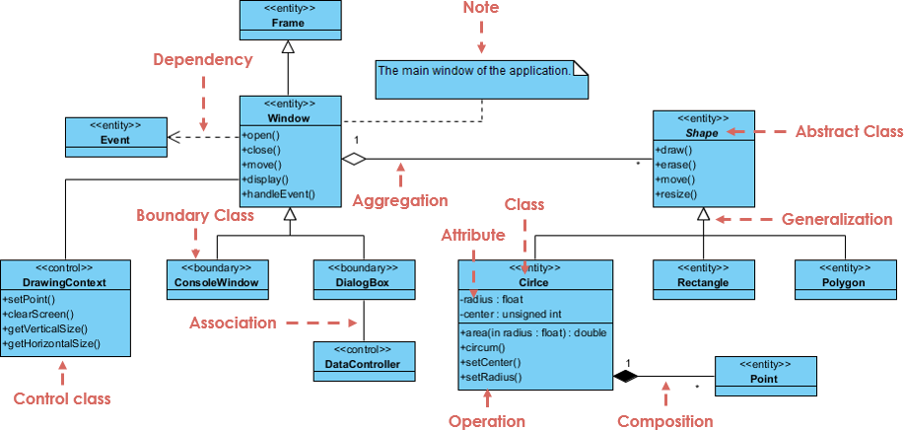
Class Diagrams
Describe the types of objects in the system and various kinds of static relationship that exist among them.
Used for requirement capture end-user interaction.
Detailed class diagrams are used for developers.

Slide 5
Class Representation
Each class is represented by a rectangle subdivided into three compartments:
Name
Attributes
Operations
Modifiers are used to indicate visibility of attributes and operations.
‘+’ is used to denote public visibility (everyone)
‘#’ is used to denote protected visibility (friends and derived)
‘-’ is used to denote private visibility (no one)
‘~’ is used to denote package visibility
By default, attributes are hidden and operations are visible.

Slide 6
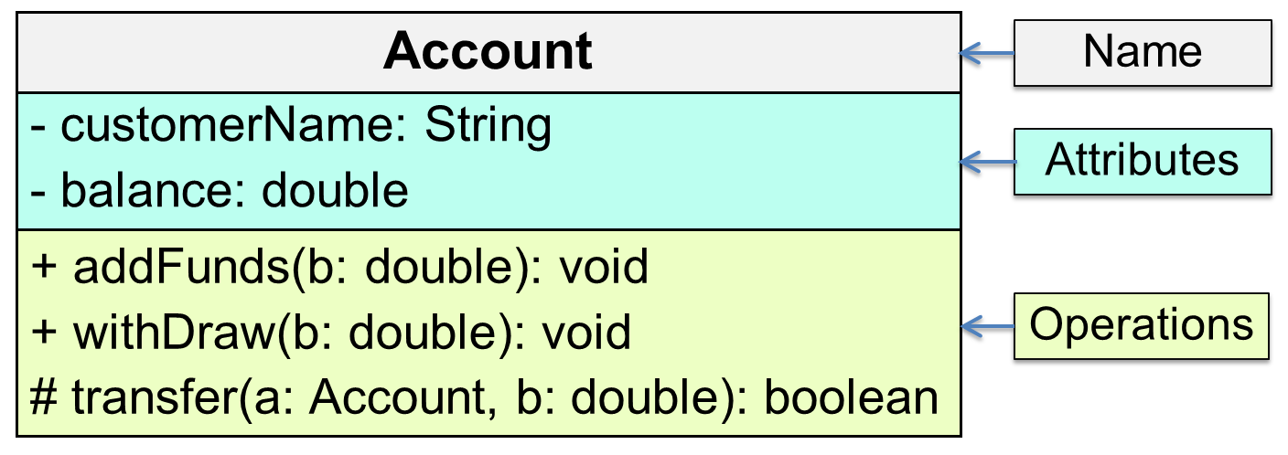
Example of Class
class Account { private String customerName; private double balance; public void addFunds(double d) { }; public void withDraw(double d) { }; protected boolean transfer(Account a, double d) { return false; }; }
The last two compartments may be omitted to simplify the class diagrams

Slide 7
Kind of Relationships
There are two kinds of Relationships:
Generalization (parent-child relationship)
Association (student enrolls in course)
The Association Relationship can be further classified as:
Aggregation
Composition

Slide 8
Generalization Relationships
Generalization expresses a parent /child relationship among related classes.
Used for abstracting details in several layers.
Supertype
Generalization
Person
Specialization
Student
Employee
Subtypes

Slide 9
Association Relationships
Represents relationship between instances of classes.
Association relationship has two ends:
Role name (e.g. enrolls)
Multiplicity (e.g. One course can have many students)
Navigability (unidirectional, bidirectional)

Slide 10
Association Relationships
One student can study any number of courses
*
4
Student
Course
Any number of students must study four courses
class Student { Course courses[] = new Course[4]; } class Course { Student students[]; }

Slide 11
Composition Relationships
Composition expresses a relationship between instances of related classes. It is a specific kind of Whole-Part relationship.
It expresses a relationship where an instance of the Whole-class has the responsibility to create and initialize instances of each Part-class.
Car
Whole
COMPOSITION
Engine
Transmission
Part

Slide 12
Aggregation Relationships
Aggregation expresses a relationship between instances of related classes. It is a specific kind of Container-Contained relationship.
It expresses a relationship where an instance of the Container-class has the responsibility to maintain instances of each Contained-class that have been used outside the Container-class.
Container
Bag
AGGREGATION
Apples
Milk
Contained

Slide 13
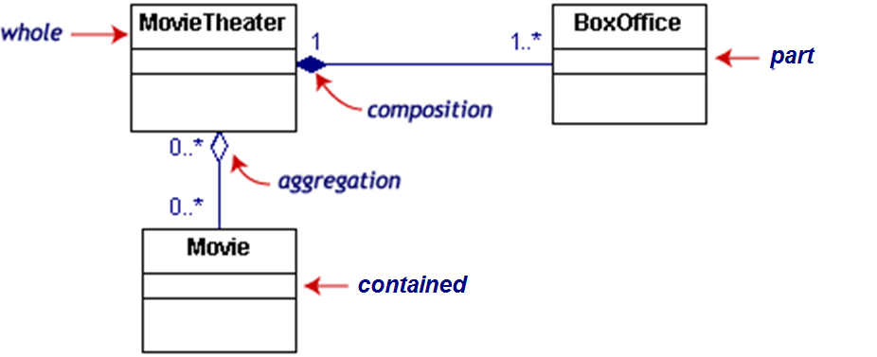
Composition and Aggregation
Composition is really a strong form of Aggregation
components have only one owner;
components cannot exist independent of their owner;
components live or die with their owner;

Slide 14
Complex Example
interface Drawable { double PI = 3.14; void draw(); }
class Color { public int r, g, b; public Color(int r, int g, int b) { this.r = r; this.g = g; this.b = b; } }
abstract class Shape { private Color color; public Shape() { this.color = new Color(0, 0, 0); } public void changeColor(int r, int g, int b) { this.color.r = r; this.color.g = g; this.color.b = b; } abstract protected double perimeter(); abstract protected double area(); }
class Point { private int x, y; public Point(int x, int y) { this.x = x; this.y = y; } }

Slide 15
Complex Example
class Circle extends Shape implements Drawable { private Point point; private double radius;
public Circle(Point point, double radius) { this.point = point; this.radius = radius; } public void draw() { System.out.println("Drawing Circle ..."); } public double perimeter() { return 2 * PI * radius; } public double area() { return PI * radius * radius; } }
Point point = new Point(47, 26);
Circle circle = new Circle(point, 19.83);
circle.draw();
circle.changeColor(127, 238, 94);

Slide 16
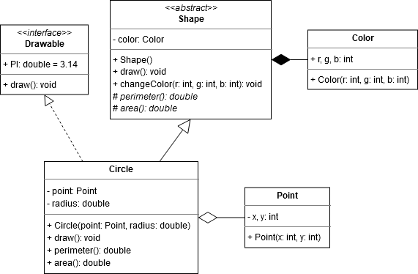
Complex Example

Slide 17
Thanks for attention!
IT Academy

